Slide 1
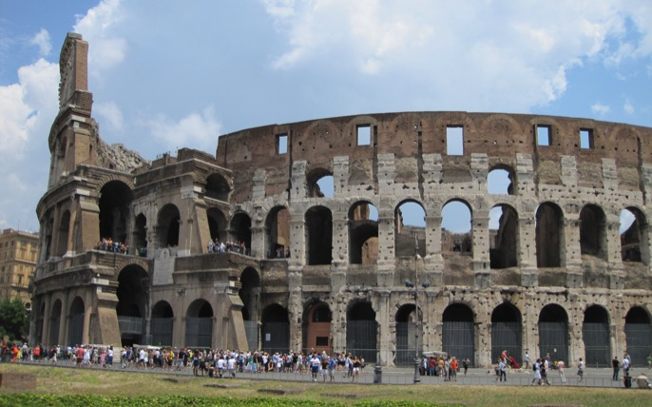
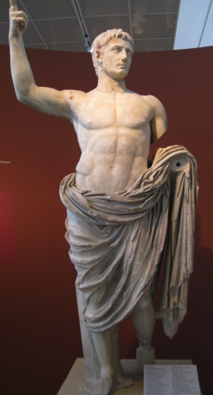
NT SURVEY/INTRODUCTION 3: EVENTS AND IDEAS THAT SHAPED THE NT WORLD by Rev Dr Lim Kar Yong

Slide 2
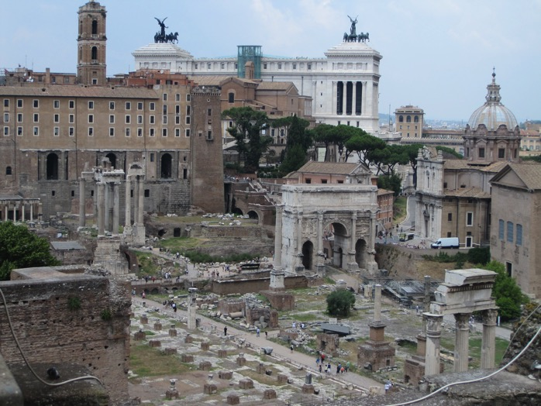
Times of Paul: Proclaiming Jesus the Messiah under the Shadow of the Empire
Life in a Roman Society

Slide 3
Communication through Letters
Ancient letter writing format
Opening section
Thanksgiving
Body
Closing
Epistolary Thanksgiving format – revealing the main theme/message of the letter

Slide 4
Roman Citizenship
Acts 22:22-29
Philippians 3:20
Ephesians 2:19

Slide 5
Marcus Papirius of Arsinre, Egypt, granted Roman citizenship after serving 25 years in the Roman Navy, dated 8 September 79

Slide 6
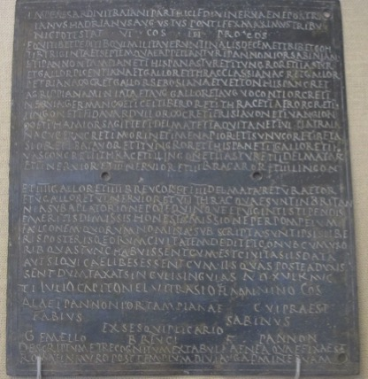
2 bronze plates forming the front and back of a 4-leaved document granting citizenship to Gemellus after 25 years of service in the army. Dated 17 July 122.

Slide 7
Roman Military
Ephesians 6:10-18

Slide 8
Household and Women
Woman leadership
Phoebe – Romans 16:1-2 –is Phoebe a Deacon?
Priscilla and Aquila – Acts 18:18-19; Romans 16:3 – note the sequence of the names

Slide 9
Household and Women
Household codes
Ephesians 5:22-6:9
Colossians 3:10-4:1

Slide 10
Classes in the Society
Masters
Slaves
Freedmen
slave and master relationship

Slide 11
Lucius Ampudius Philomusus, a freed slave and his family. On either side are corn measures, showing that he was a corn trader, a lucrative trade. Dated circa 15BCE - 5CE

Slide 12
Publius Licinius Philonicus and Publius Licinius Demetrius, dated 30-10 BCE, near Rome. Left - rods and axes used in ceremony of freeing a slave Right - tools of a carpenter Pediment – tools of a smith or moneyer

Slide 13
Classes in the Society
Reading Philemon in light of social classes in the society

Slide 14
Patrons and Clients
Why did Paul accept financial support from Philippi, acknowledge the support of Phoebe, his patron (Romans 16:1-2) and yet refuse the financial support from Corinth (1 Corinthians 9:15-18)?
The language of grace (Charis) = language of benefaction

Slide 15
Religion and philosophy
Paul’s Areopagus’ Speech – Acts 17:16-31

Slide 18
Religion and philosophy
Paul’s confrontation with the Asklepious cult in Corinth

Slide 20
Marble relief of left leg with inscription dedicating it to Asklepios and Hygeia (health) from Tyche as thank offering, presumably for cure of affliction on the leg

Slide 21
The Asklepios at Corinth

Slide 22
The Dining Rooms of the Asklepios

Slide 23
Statue of Asklepios

Slide 24
Religion and philosophy
Paul’s ministry in Ephesus – Acts 19
Ephesians 1:15-23; 6:10-18 – Christ above all powers

Slide 25
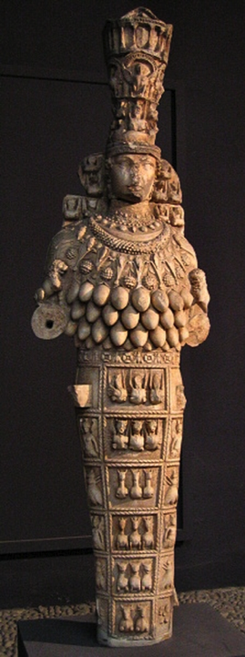
Remains of the temple of Artemis in Ephesus, with a reconstructed column

Slide 26
Terracotta figure of Artemis of Ephesus – 1st Century Found in Turkey. Roman version. Asiatic version of the goddess of fertility, looks slightly different from the Greek deity of the same name

Slide 27
Religion and philosophy
Colossians 2:8, 20-23 – asceticism
How to preach the gospel in a pluralistic context?

Slide 28
Aphrodite, daughter of Zeus. Greek goddess of love, beauty and fertility. Shown here with Eros, god of love and her child by Ares.

Slide 29
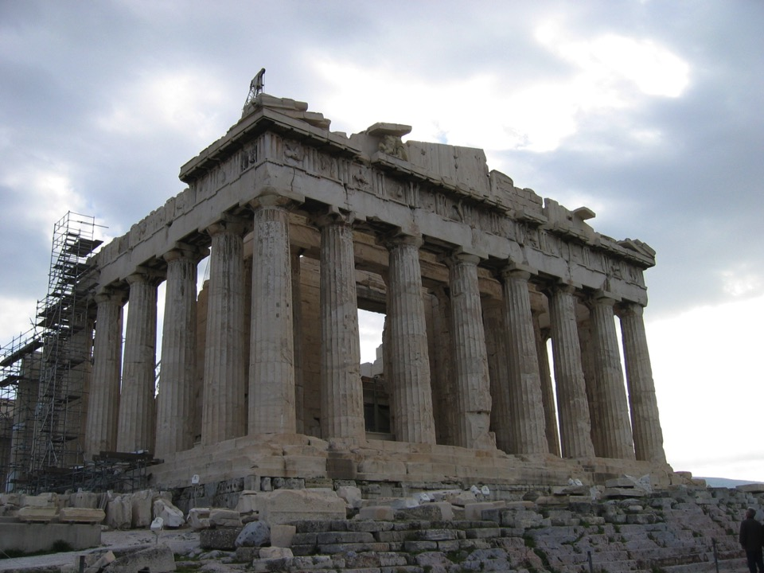

Slide 36
Religion and philosophy
Colossians 2:8, 20-23 – asceticism
Other gods

Slide 37
Imperial Cult
Romans 1:18-31 – Paul’s critique of the Roman Imperial household and the prevailing lifestyle in Roman society
Note 3 times Paul uses the phrases “God gave them over” in Romans 1:24, 26, 28
Philippians 2:5-11

Slide 40
Statue of Augustus
Deified Julius Caesar who established Roman Corinth was venerated soon after his death
Celebrations of imperial festivals required by all citizens

Slide 41
“Since Providence, which has ordered all things and is deeply interested in our life, has set in most perfect order by giving us Augustus, whom she filled with virtue that he might benefit humankind, sending him as a savior [swth,r], both for us and for our descendants, that he might end war and arrange all things, and since he, Caesar, by his appearance [evpifanei/n] (excelled even our anticipations), surpassing all previous benefactors, and not even leaving to posterity any hope of surpassing what he has done, and since the birthday of the god Augustus was the beginning of the gospel for the world that came by reason of him”
Calendar inscription from Priene (c. 9 BC) on the birth of Augustus

Slide 42
The Son of God
Son of God
42 BCE, Julius Caesar formally deified as "the divine Julius" (divus Iulius)
His adopted son, Octavian (better known by the title "Augustus”) became known as "divi Iuli filius" (son of the divine Julius) or simply "divi filius" (son of the Divine One)
Augustus used this title as a propaganda tool to advance his political position, overcoming all rivals for power within the Roman state.

Slide 43
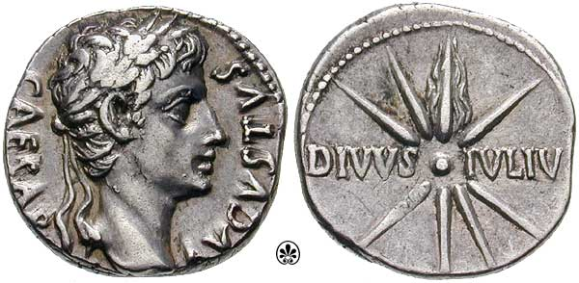
Coins bearing “son of God”

Slide 44
Head of Livia, wife of Augustus, shown with characteristics of Ceres the goddess of corn

Slide 45
Challenges as a Christ-follower in Pauline community
Think about the challenges of a Christ-believer living under the shadow of the Empire.
What about us who are also living under the shadow of another present day Empire in Malaysia? What does this speak about our commitment and discipleship?

Slide 46
Personal Reflections
Imagine you are a Christ-follower living in the times of Paul. Would you be attracted to the gospel proclaimed by Paul? How would understanding the events and ideas that shaped the New Testament world impact and challenge you to live your faith as a Christ-follower?

