Slide 1
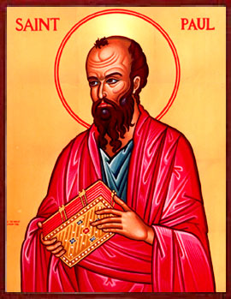
Acts & Paul’s Life and Ministry

Slide 2
Acts and Paul’s Life
Paul does not say much about his life from his letters. Much of what we know about his background and his missionary activities come from Acts

Slide 3
Acts and Paul’s Life
Acts remains a selective source of information, and does not tell us the full picture, and it remains a secondary source on Paul (eg – what did Paul do between his call/conversion and 1st missionary journey? What did Paul do in his 18-month stay at Corinth? What happened after Acts 28?)

Slide 4
Acts and Paul’s Life
Relatively few dates to anchor Paul’s life – eg., 51/52CE – Paul before Gallio in Corinth; 58-59CE – Paul in Caesarea during last part of the leadership of Felix.

Slide 5
The World of Paul
The Jewish world
Paul’s education and training under Gamaliel (Acts 5:34; 22:3)
Paul’s understanding of the Law
Paul’s life as a Pharisee

Slide 6
The World of Paul
The Greco-Roman world
Paul’s hometown – Tarsus (cf. Acts 21:39)
Paul’s exposure to the Hellenistic world – rhetoric, the art of letter writing, and his proficiency in Greek

Slide 7
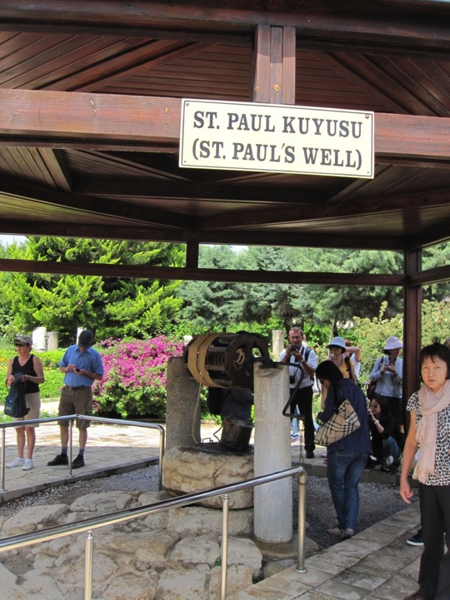
St Paul’s Well at Tarsus

Slide 8
Ancient Agora in Tarsus

Slide 9
The World of Paul
The Christian world
Paul’s Jewish and Greco-Roman world prepared him for his ministry
Damascus road encounter with the risen Christ (Acts 9)
Reorientation of his life (Phil 3:7-11)
Reinterpretation of scripture configured around Jesus the Messiah

Slide 10
Discussion
In your opinion, how would Paul’s exposure to the Jewish and Greco-Roman world prepare him for his mission to the Gentiles?
Reflect on your own life. How would your life experiences in the past prepare you for your ministry today and in the future? Share 1 or 2 insights/experiences from your life.

Slide 11
Acts 7
First encounter of Paul – persecutor of the church & the stoning of Steven

Slide 12
Acts 9
Paul’s conversion and call
Damascus, “a few days” (Acts 9:19b) then to Arabia (Gal 1:16-17); total time of 3 years (what did Paul do in Arabia?)
Return to Damascus (Gal 1:17; Acts 9:20-25).
Escape in basket (2 Cor 11:32-33; Acts 9:23-25)

Slide 13
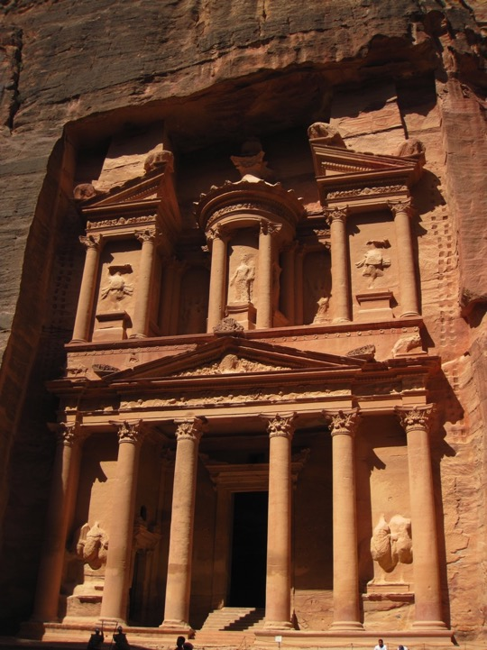
The famous library, Petra

Slide 14
The Roman Street, Petra, Jordan

Slide 15
What was Paul doing?
What was Paul doing during his years in the Arabian desert that even King Aretas wanted to arrest him?

Slide 16
Acts 9:30
Back to Tarsus after meeting the leaders in Jerusalem
“Silent years” until Acts 11:25 where Barnabas sought Paul
The role of Barnabas

Slide 17
Antioch
Paul made Antioch his “gentile missionary headquarters” and base.

Slide 18
Modern day Antioch - Antakya

Slide 19
Antakya: What happened to the gentile mission headquarters which now has hardly any Christian presence?

Slide 20
Missionary Journey 1
Acts 13:1-14.28
Cyprus and Southern Galatia: Antioch-Cyprus-Pamphylia-Pisidia-Iconium-Lystra-Derbe-Antioch.

Slide 22
Cyprus
Acts 13:4-12
John Mark left the team at Perga and returned to Jerusalem

Slide 23
Pisidian Antioch
Acts 13:13-52
Great success
Large crowd (‘whole city”) on 2nd Sabbath, causing Jews to be jealous and stirring up problems/persecutions
Warm reception by Gentiles

Slide 24
Iconium
Acts 14:1-7
Persecution again

Slide 25
Lystra
Acts 14:8-20
Gods from heaven?
Paul being stoned and dragged outside the city

Slide 26
Return to Antioch
Acts 14:21-28
Appointing leaders for the church on return journey
Back to Antioch

Slide 27
Controversy & Conflict
Acts 15:1-35
Jerusalem council meeting

Slide 28
Discussion: Controversy & Conflict
Imagine that the decision of the Jerusalem council is to exclude Gentiles as the people of God and to enforce Jewish law on the Gentiles proselytes. How would this change the face of mission in the days of Paul and today?

Slide 29
Missionary Journey 2
Acts 15:36-18:22
Macedonia and Achaia: Antioch, Syria, Cicilia, Derbe, Lystra, Phrygia-Galatia, Philippi, Thessalonica, Berea, Athens, Corinth (for 18 months), Cenchreae, Ephesus, Caesarea, Jerusalem, Antioch.

Slide 31
Second Missionary Journey
Acts 15:36-18:22
Off to a bad start?

Slide 32
Second Missionary Journey
Acts 15:36-18:22
Off to a bad start?

Slide 33
Second Missionary Journey
Do you think the severe conflict between Paul and Barnabas could have been better resolved?
Do you think this major disagreement would have any severe implications for mission?

Slide 34
Macedonian Vision

Slide 35
Neapolis

Slide 36
Port of Neapolis today

Slide 37
Via Egnatia from Neapolis up to Philippi

Slide 38
Philippi

Slide 39
Philippi
No synagogue → less than 10 male Jews

Slide 40
Philippi
Lydia and the household
First gentile church in Europe
Acts 16:15, 40

Slide 41
Philippi
Slave girl: “These men are the servants of the Most High God who are telling you a way to salvation”
Why did Paul cast out the Pythonian spirit in this girl?
Read: “oi[tinej katagge,llousin u`mi/n o`do.n swthri,aj (Acts 16:17): Is Paul Proclaiming The Way or A Way of Salvation?” MATS Journal (2010): 73-86

Slide 42
Philippi
Paul before the city magistrates
The charge (16:20-12):
“these men are Jews, and are throwing our city into an uproar by advocating customs unlawful for us Romans to accept and practice.”
The verdict: stripped, beaten with rods, imprisonment

Slide 43
Philippi
Jailhouse ROCK!!
The jailor believes

Slide 44
Philippi
Paul and Roman citizenship

Slide 45
A mosaic inscription found on the pavement in Philippi, dated around 313-343 CE. This mosaic mentioned that a church was dedicated to St Paul by Bishop Porphyrios, the Bishop of Philippi. The Cctagonal church that was subsequently built around 400 CE, replaced the first small church dedicated to St Paul

Slide 46
Philippi
The believers in Philippi and their social location:
Lydia
Slave girl
Jailor
What does this suggest about the first European church?
Is there a biblical basis for “homogeneous church”?

Slide 47
Thessolonica

Slide 48
The Ancient agora, Thessolonica, where Jason and other believers would have faced the πολιτάρχης (politarches), the city officials

Slide 49
Local honorary decree by the local authorities of Kalindoia bestows honours on the priest Appollonius.
1st c. CE
Archeaological Musuem, Thessaloniki

Slide 50
Berea

Slide 51
Athens

Slide 52
According to ancient practice, each orator is given a time limit of 6 minutes to address the crowd, and a water timekeeping device may have been used to keep track of the time. A water timekeeping device can be found in the small museum in the agora today.

Slide 53
Paul a “babbler”?
ὁ σπερμολόγος - Literally this word means a bird picking up bits and pieces of seeds all over the place. Used figuratively, it is a pejorative imagery of persons whose communication lacks sophistication and seems to pick up scraps of information here and there.

Slide 55
When they heard about the resurrection of the dead, some of them sneered, but others said, “We want to hear you again on this subject.”
– Acts 17:32

Slide 56
Corinth
Proconsul Gallio at Corinth (Acts 18:12)
The most significant archaeological evidence for dating the New Testament events

Slide 57
Corinth
Paul’s second vision
Paul before Gallio
The charge: “this man is persuading the people to worship God in ways contrary to the law”

Slide 58
Corinth
2 Cor 5:10 – another bema

Slide 59
Erastus Inscription

Slide 60
ERASTVS. PRO. AED. S. P. STRAVIT, which is an abbreviation of ERASTUS PRO AEDILITATE SUA PECUNIA STRAVIT.
“Erastus, in return for his aedileship, laid this pavement at his own expense”

Slide 61
Cf. Romans 16:23 “Erastus, who is the city's director of public works,…send you their greetings.”
οἰκονόμος – public treasurer

Slide 62
Paul Leaves Corinth
Acts 18:18 – sailing from Cenchrea to Asia Minor

Slide 63
End of Missionary Journey 2
Acts 18:22

Slide 64
Discussion
Revisit all the major cities Paul visited during his 2nd Missionary Journey. What are some of the highlights/results of his ministry?
What is the price that Paul paid for his ministry in obedience to the two visions he had (the Macadonian vision and the Corinthian vision)?

