Slide 1
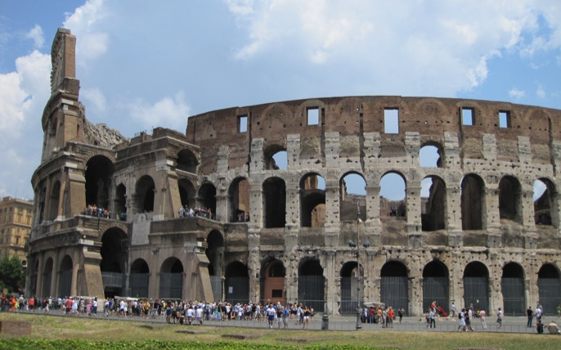
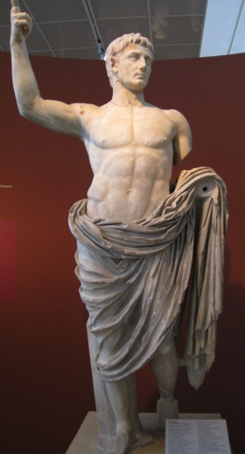
NT SURVEY/INTRODUCTION 1: EVENTS AND IDEAS THAT SHAPED THE NT WORLD by Rev Dr Lim Kar Yong

Slide 2
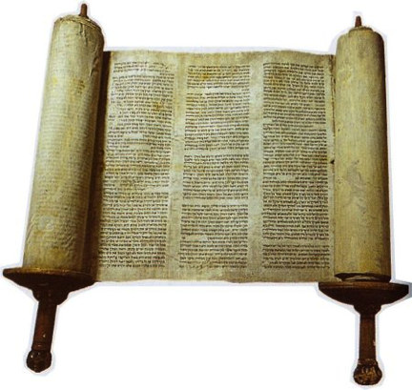
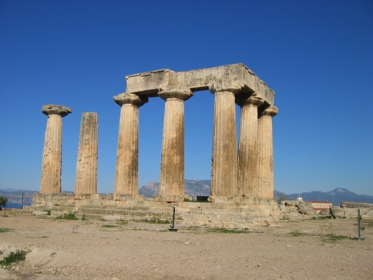
The World of the New Testament
Melting pot of:
The Jewish world
The Greco-Roman world

Slide 3
The History of the Intertestamental Period
Moving from Malachi to Matthew: 400 years of history.
Importance of knowing and understanding this period of history – crucial for our understanding of the NT and the mission and ministry of Jesus and St Paul

Slide 4
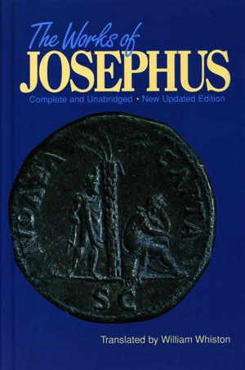
Sources of Information
Old and New Testaments
Jewish Sources
Writings of Josephus – the Jewish War and the Antiquities as the most important

Slide 5
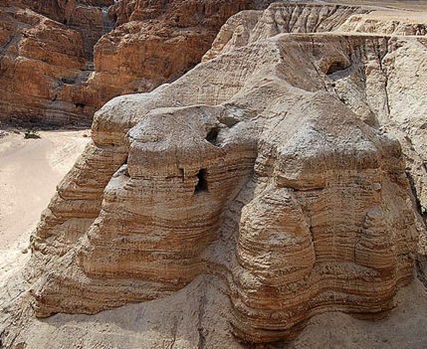
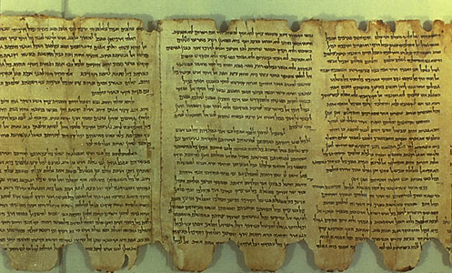
Sources of Information
Dead Sea Scrolls – discovered around 1946-47.
Most important is 1QS – The Rule of the Community (6.5ft in length by 10 inches wide)

Slide 6
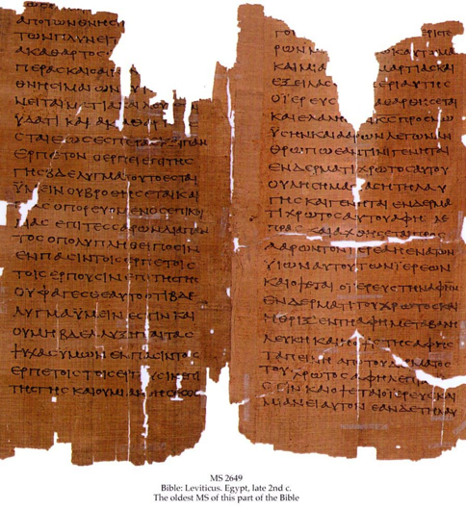
Sources of Information
Septuagint (LXX) – Greek translation of the Hebrew bible

Slide 7
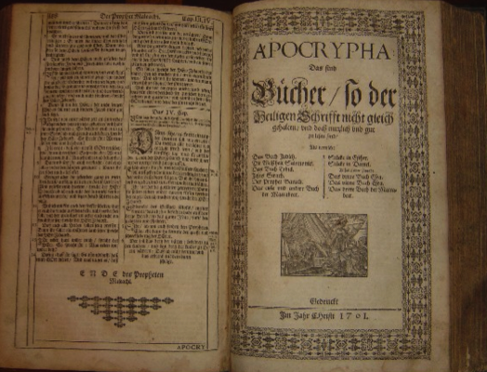
Sources of Information
Apocrypha – most important 1 Maccabees – describing the events around 167BCE, most notably the “abomination that causes desolation”
Pseudepigrapha – Psalms of Solomon most important

Slide 8
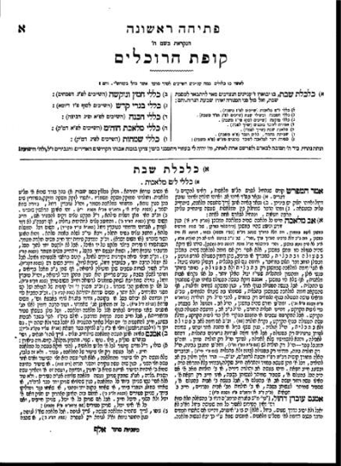
Sources of Information
Mishnah – sayings/teachings of the rabbis on observing the Law
Targums – commentary on the Hebrew Bible

Slide 9
Where OT Left Us: The Exile and the Return from the Exile
Political background:
The Babylonian Exile and Persian Rule (586-331BCE)
Loss of Land
Loss of Temple
Loss of Kingship

Slide 10
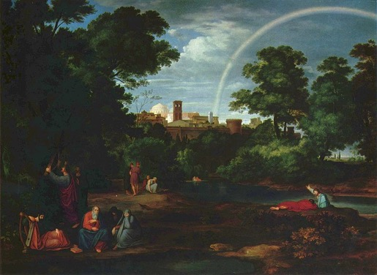
Where OT Left Us: The Exile and the Return from the Exile
Political background:
By the rivers of Babylon, we lay down and wept…how shall we sing the Lord’s song in a strange land?

Slide 11
Where OT Left Us: The Exile and the Return from the Exile
Political background:
Learning to live in Exile (the diaspora)
Renewed focus on the Law
Origins of the synagogues?
“Seek the welfare of the city…” (Jer 29:7)

Slide 12
Where OT Left Us: The Exile and the Return from the Exile
Political background:
Return to the LAND – under the Persian ruler Darius Hystaspes I (522-486 BCE).
The HOPE for a king (Zerubbabel, governor of Jerusalem): “the righteous branch” – see Ezra
The rebuilding of Jerusalem and the temple (Nehemiah Haggai)
Renewed emphasis on holiness, purity, obedience (Ezra)

Slide 13
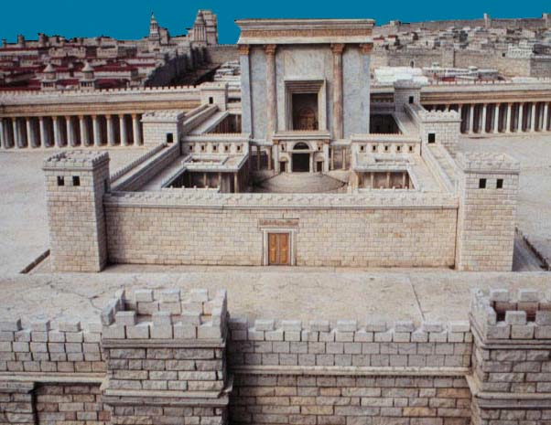
Where OT Left Us: The Exile and the Return from the Exile
Political background:
Second Temple Judaism

Slide 14
Where OT Left Us: The Exile and the Return from the Exile
Some FACTS:
Relatively few Jews did return – most remain in the Mediterranean world and Egypt → diaspora
Rebuilding of the temple was slow – see Ezra-Nehemiah; Haggai

Slide 15
Where OT Left Us: The Exile and the Return from the Exile
Some FACTS:
Returning Jews subject to Persian rule, Greeks and Romans
There remains no independence – looking forward to the restoration of the glorious Davidic kingdom
Jews struggling to maintain their religious and social identity

Slide 16
Where OT Left Us: The Exile and the Return from the Exile
Questions:
Where is the Land promised to us?
Can we worship God without the Temple?
How can God be sovereign if we are still under the domination of foreign powers?

Slide 17
Where OT Left Us: The Exile and the Return from the Exile
Political Background - Hellenistic Period (331-167BCE):
Alexander the Great (331-323BCE)
Ptolemies (323-198BCE)
Seleucids (198-167BCE) → tumultuous time

Slide 18
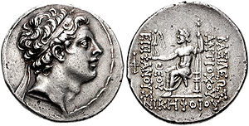
Desecration of the Temple
Antiochus Epiphanes
1 Maccabees
Zeus (King of the Gods) enthroned, carrying Nike (Victory). The legend reads: ‘King Antiochus Epiphanes (God Manifest), bearing victory’

Slide 19
1 Maccabees 1:10-15
The wicked ruler Antiochus Epiphanes, son of King Antiochus the Third of Syria, was a descendant of one of Alexander's generals. Antiochus Epiphanes had been a hostage in Rome before he became king of Syria in the year 137 (175 BCE). At that time there appeared in the land of Israel a group of traitorous Jews who had no regard for the Law and who had a bad influence on many of our people. They said,

Slide 20
1 Maccabees 1:10-15
Let's come to terms with the Gentiles, for our refusal to associate with them has brought us nothing but trouble. This proposal appealed to many people, and some of them became so enthusiastic about it that they went to the king and received from him permission to follow Gentile customs. They built in Jerusalem a stadium like those in the Greek cities. They had surgery performed to hide their circumcision, abandoned the holy covenant, started associating with Gentiles, and did all sorts of other evil things.

Slide 21
1 Maccabees 1:20-25
In the year 143 (169BCE), after the conquest of Egypt, Antiochus marched with a great army against the land of Israel and the city of Jerusalem. In his arrogance, he entered the Temple and took away the gold altar, the lampstand with all its equipment, the table for the bread offered to the Lord, the cups and bowls, the gold fire pans, the curtain, and the crowns.

Slide 22
1 Maccabees 1:20-25
He also stripped all the gold from the front of the Temple and carried off the silver and gold and everything else of value, including all the treasures that he could find stored there. Then he took it all to his own country. He had also murdered many people and boasted arrogantly about it. There was great mourning everywhere in the land of Israel.

Slide 23
1 Maccabees 1:29-40
Two years later Antiochus sent a large army from Mysia against the towns of Judea. When the soldiers entered Jerusalem, their commander spoke to the people, offering them terms of peace and completely deceiving them. Then he suddenly launched a fierce attack on the city, dealing it a major blow and killing many of the people.

Slide 24
1 Maccabees 1:29-40
He plundered the city, set it on fire, and tore down its buildings and walls. He and his army took the women and children as prisoners and seized the cattle. Then Antiochus and his forces built high walls and strong towers in the area north of the Temple, turning it into a fort. They brought in a group of traitorous Jews and installed them there. They also brought in arms and supplies and stored in the fort all the loot that they had taken in Jerusalem. This fort became a great threat to the city.

Slide 25
1 Maccabees 1:29-40
The fort was a threat to the Temple, a constant, evil menace for Israel. Innocent people were murdered around the
altar; the Holy Place was defiled by murderers. The people of Jerusalem fled in fear, and the city became a colony of foreigners. Jerusalem was foreign to its own people, who had been forced to abandon the city.

Slide 26
1 Maccabees 1:29-40
Her Temple was as empty as a wilderness; her festivals were turned into days of mourning, her Sabbath joy into shame. Her honor became an object of ridicule.
Her shame was as great as her former glory, and her pride was turned into deepest
mourning.

Slide 27
1 Maccabees 1:41-63
Antiochus now issued a decree that all nations in his empire should abandon their own customs and become one people. All the Gentiles and even many of the Israelites submitted to this decree. They adopted the official pagan religion, offered sacrifices to idols, and no longer observed the Sabbath.

Slide 28
1 Maccabees 1:41-63
The king also sent messengers with a decree to Jerusalem and all the towns of Judea, ordering the people to follow customs that were foreign to the country. He ordered them not to offer burnt offerings, grain offerings, or wine offerings in the Temple, and commanded them to treat Sabbaths and festivals as ordinary work days. They were even ordered to defile the Temple and the holy things in it.

Slide 29
1 Maccabees 1:41-63
They were commanded to build pagan altars, temples, and shrines, and to sacrifice pigs and other unclean animals there. They were forbidden to circumcise their sons and were required to make themselves ritually unclean in every way they could, so that they would forget the Law which the Lord had given through Moses and would disobey all its commands. The penalty for disobeying the king's decree was death.

Slide 30
1 Maccabees 1:41-63
The king not only issued the same decree throughout his whole empire, but he also appointed officials to supervise the people and commanded each town in Judea to offer pagan sacrifices. Many of the Jews were ready to forsake the Law and to obey these officials. They defiled the land with their evil, and their conduct forced all true Israelites to hide wherever they could.

Slide 31
1 Maccabees 1:41-63
On the fifteenth day of the month of Kislev in the year 145 (167BCE), King Antiochus set up the abomination that causes desolation on the altar of the Temple, and pagan altars were built in the towns throughout Judea. Pagan sacrifices were offered in front of houses and in the streets. Any books of the Law which were found were torn up and burned, and anyone who was caught with a copy of the sacred books or who obeyed the Law was put to death by order of the king. Month after month these wicked people used their power against the Israelites caught in the towns.

Slide 32
1 Maccabees 1:41-61
On the twenty-fifth of the month, these same evil people offered sacrifices on the pagan altar erected on top of the altar in the Temple. Mothers who had allowed their babies to be circumcised were put to death in accordance with the king's decree. Their babies were hung around their necks, and their families and those who had circumcised them were put to death.

Slide 33
Summary of the Horror Stories
Interfering in the appointment of high priests in temple
Building of gymnasium near the temple – alien to Jewish culture
167BCE – desecrated the temple, rededicated to Zeus
Prohibiting the observance of Jewish law, especially circumcision, Sabbath, food laws, and the practice of Judaism

Slide 34
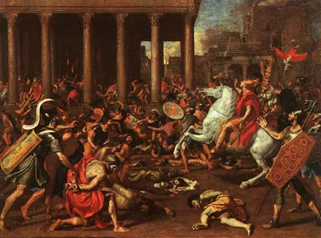
SUMMARY:
The political, religious, social, and ethnic identity of Jews all stripped away
SO, WHO IS A JEW NOW?

Slide 35
Think:
If you are a Jew living in this period, how would you have reacted to the circumstances surrounding you?

Slide 36
More Tumultuous Times :
The Maccabean Revolt (167-63BCE)- 1 Maccabees 2
During that time, a priest of the Jehoiarib family named Mattathias…When Mattathias saw all the sins that were being committed in Judea and Jerusalem, he said:

Slide 37
More Tumultuous Times :
Why was I born to see these terrible things, the ruin of my people and of the holy city? Must I sit here helpless while the city is surrendered to enemies and the Temple falls into the hands of foreigners? The Temple is like someone without honor. Its splendid furnishings have been carried away as loot. Our children have been killed in the streets, and our young men by the sword of the enemy. Every nation in the world has occupied the city and robbed her of her possessions. All her ornaments have been stripped away; she is now a slave, no longer free. Look at our Temple, profaned by the Gentiles, emptied of all its splendor. Why should we go on living?

Slide 38
More Tumultuous Times :
The Maccabean Revolt – 1 Maccabees 2
Then the king's officials, who were forcing the people to turn from God, came to the town of Modein to force the people there to offer pagan sacrifices…one of the men from Modein decided to obey the king's decree and stepped out in front of everyone to offer a pagan sacrifice on the altar that stood there. When Mattathias saw him, he became angry enough to do what had to be done. Shaking with rage, he ran forward and killed the man right there on the altar. He also killed the royal official who was forcing the people to sacrifice, and then he tore down the altar.

Slide 39
More Tumultuous Times :
The Maccabean Revolt – 1 Maccabees 2
….Then Mattathias and his friends were joined by a group of devout and patriotic Jews, the strongest and bravest men in Israel, who had all volunteered to defend the Law. In addition, everyone who was fleeing from the persecution joined them and strengthened their forces.

Slide 40
More Tumultuous Times :
The success of the Revolt
The rededication of the temple (and the celebration of Hanukkah – see John 10:22-23, and the discourse on the Good Shepherd)

Slide 41
More Tumultuous Times :
Hasmonean Dynasty – the merging of kingship and priestly office into one
Fall of Jerusalem to the Romans in 63BCE
Pompey marched into Jerusalem
Beginning of the Roman rule in Palestine
The first Jewish War (66-70CE), and the final destruction of the Temple
The second revolt, the Bar Jochba revolt (132-135CE) under Hadrian

